Slide 1
HELL
NOT A PLACE YOU WANT TO SPEND ETERNITY!

Slide 2
Introduction
There is a lot of speculation about Hell. What we need to understand is this: If Heaven is real then so is Hell. Also if Heaven is eternal presence with God then Hell is eternal separation from God. This afternoon we want to look at Hell as a place in which, sadly, most people will find themselves for eternity.

Slide 3
Facts about Hell
Hell is a demonstration of God’s justice:
“This is evidence of the righteous judgment of God, that you may be considered worthy of the kingdom of God, for which you are also suffering since indeed God considers it just to repay with affliction those who afflict you, and to grant relief to you who are afflicted as well as to us, when the Lord Jesus is revealed from heaven with His mighty angels in flaming fire, inflicting vengeance on those who do not know God and on those who do not obey the gospel of our Lord Jesus. They will suffer the punishment of eternal destruction, away from the presence of the Lord and from the glory of his might.”
2 Thessalonians 1:5-9

Slide 4
Hell Is A Choice We Make While Alive
“For we must all appear before the judgment seat of Christ, so that each one may receive what is due for what he has done in the body, whether good or evil. Therefore, knowing the fear of the Lord, we persuade others. But what we are is known to God, and I hope it is known also to your conscience.” 2 Corinthians 5:10-11

Slide 5
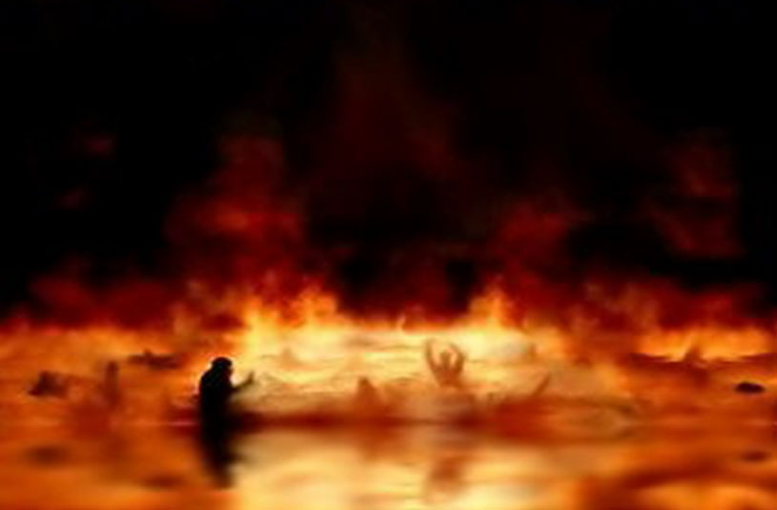
Six Descriptive Terms Of Hell

Slide 6
Eternal Stench
Sulfur (Rotten Eggs):
“And the beast was captured, and with it the false prophet who in its presence had done the signs by which he deceived those who had received the mark of the beast and those who worshiped its image. These two were thrown alive into the lake of fire that burns with sulfur.” Revelation 19:20
“… and the devil who had deceived them was thrown into the lake of fire and sulfur where the beast and the false prophet were, and they will be tormented day and night forever and ever.” Revelation 20:10
Notes:
This is eternal stench

Slide 7
Eternal Darkness
“… wild waves of the sea, casting up the foam of their own shame; wandering stars, for whom the gloom of utter darkness has been reserved forever.” Jude 13
“Then the king said to the attendants, ‘Bind him hand and foot and cast him into the outer darkness. In that place there will be weeping and gnashing of teeth.’” Matthew 22:13
“And cast the worthless servant into the outer darkness. In that place there will be weeping and gnashing of teeth.” Matthew 25:30
“These are waterless springs and mists driven by a storm. For them the gloom of utter darkness has been reserved.” 2 Peter 2:17

Slide 8
Eternal Unquenchable Fire
“And if your hand causes you to sin, cut it off. It is better for you to enter life crippled than with two hands to go to hell, to the unquenchable fire.” Mark 9:43
“And if your hand or your foot causes you to sin, cut it off and throw it away. It is better for you to enter life crippled or lame than with two hands or two feet to be thrown into the eternal fire.” Matthew 18:8

Slide 9
Eternal Pain
“… and throw them into the fiery furnace. In that place there will be wailing and gnashing of teeth.” Matthew 13:50
“… and will cut him in pieces and put him with the hypocrites. In that place there will be wailing and gnashing of teeth.” Matthew 24:51
“In that place there will be wailing and gnashing of teeth, when you see Abraham and Isaac and Jacob and all the prophets in the kingdom of God but you yourselves cast out.” Luke 13:28

Slide 10
Eternal Worm
“… where their worm does not die and the fire is not quenched.” Mark 9:48
“For if, after they have escaped the defilements of the world through the knowledge of our Lord and Savior Jesus Christ, they are again entangled in them and overcome, the last state has become worse for them than the first. For it would have been better for them never to have known the way of righteousness than after knowing it to turn back from the holy commandment delivered to them.” 2 Peter 2:20-21

Slide 11
Eternal Separation from God
“They will suffer the punishment of eternal destruction, away from the presence of the Lord and from the glory of His might.”
2 Thessalonians 1:9

Slide 12
We Will All Die
“And just as it is appointed for man to die once, and after that comes judgment.” Hebrews 9:27

Slide 13
Matthew 7:21-23

Slide 14
CONCLUSION
Not A Pretty Place
Eternal Stench
Eternal Darkness
Eternal Unquenchable Fire
Eternal Pain
Eternal Worm
Eternal Separation from God

Slide 15
FREEDOM FROM HELL
Hear: Romans 10:17
Believe: John 8:24; John 3:16
Repent: Luke 13:3
Confess: Matthew 10:32; Acts 8:37
Be Baptized: Mark 16:16; Acts 2:38
Remain Faithful: Revelation 2:10

